Slide 1
Contract Analysis Unsupervised Classification – Review
Shivanshu Verma, IIT Delhi

Slide 2
Overview
Identifying clauses for various products and services.
Unsupervised Modeling on Contracts dataset for predicting clause category of the particular section of text.
Prevention of Revenue Leakage

Slide 3
Why Unsupervised?
Data labelling – Manual Process - time consuming
Required to be updated regularly
Risk of Overfitting and wrong prediction

Slide 4
Data Preparation
Data we have
Logical Unit
Raw data – Scanned Pdfs converted into text files using OCR
Labelled text with their respective clauses (approx. 4800 examples)
Complete file was splitted into logical units which are paragraphs.
Unsupervised categories are completely unknown and may be the mixture of different classes
Notes:
Tabular – Logical unit
Data preparation

Slide 5
Approach
Logical Unit Data
Unsupervised Model
Analysis of Output Classes
Document name | Page No. | Paragraph text
---------- | -------- | -------------- --------------
Latent Dirichlet Allocation
LDA Mallet
Clustering
Which output class represents which clause
How many clauses are separable?

Slide 6
Topic Modeling (LDA)
Preprocessing of Logical Units
LDA Model
Analysis of Output Topics
Word lemmatization
Stopwords and punctuation removal
Vectorization of paragraphs
Used bigrams and unigrams as the feature vectors
Hyperparameter tuning with number of topics and different parameters.
Model performance testing on labelled data set for analyzing output topics
Counted number of different clauses in different topics
Notes:
Manual stopwords list after analyzing words’ probability

Slide 7
LDA Output Results
Output results of LDA with configuration 100 topics, bigram + unigram, default stopwords

Slide 8

What does this output mean? Is it really useful?
Expectations
Results
We’ll get different topics for different clauses.
For each clauses, there will be many topics but each topic will be of different clause.
A complete mess between topics and clauses.
Unable to extract any useful information from unsupervised classification
Can we use another model over it to separate the mixture of clauses?

Slide 9
New Approach
Logical Unit Data
Unsupervised Model
Supervised
Mapping
Results
LDA + SVM
The output of unsupervised model was manually unpredictable.
Used this output as input features for supervised model and map them to defined clauses using same.
A feature vector of hundred topics probability was used as an input for support vector classification.

Slide 10
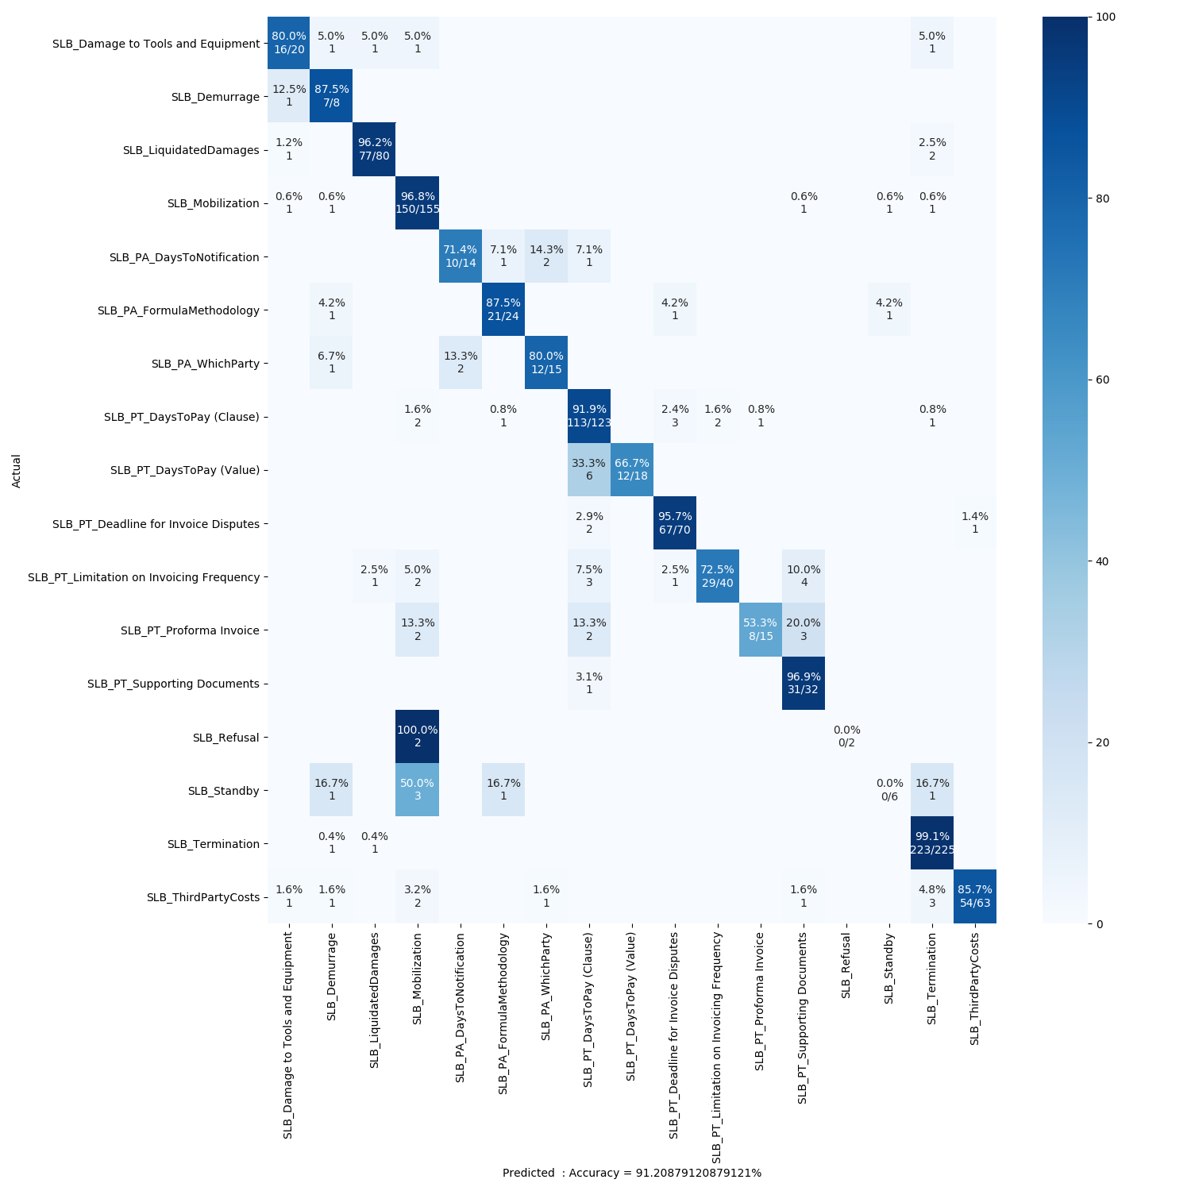
LDA + SVM Output Results
Predicted Accuracy is :
91.2 %
Confusion matrix of SVM model with LDA features as input

Slide 11
Different Unsupervised Models
Unsupervised Models
Clustering
K Means
Hierarchical Clustering
Topic Modeling
LDA
Gaussian Mixture Models
LDA Mallet
LDA2VEC

Slide 12
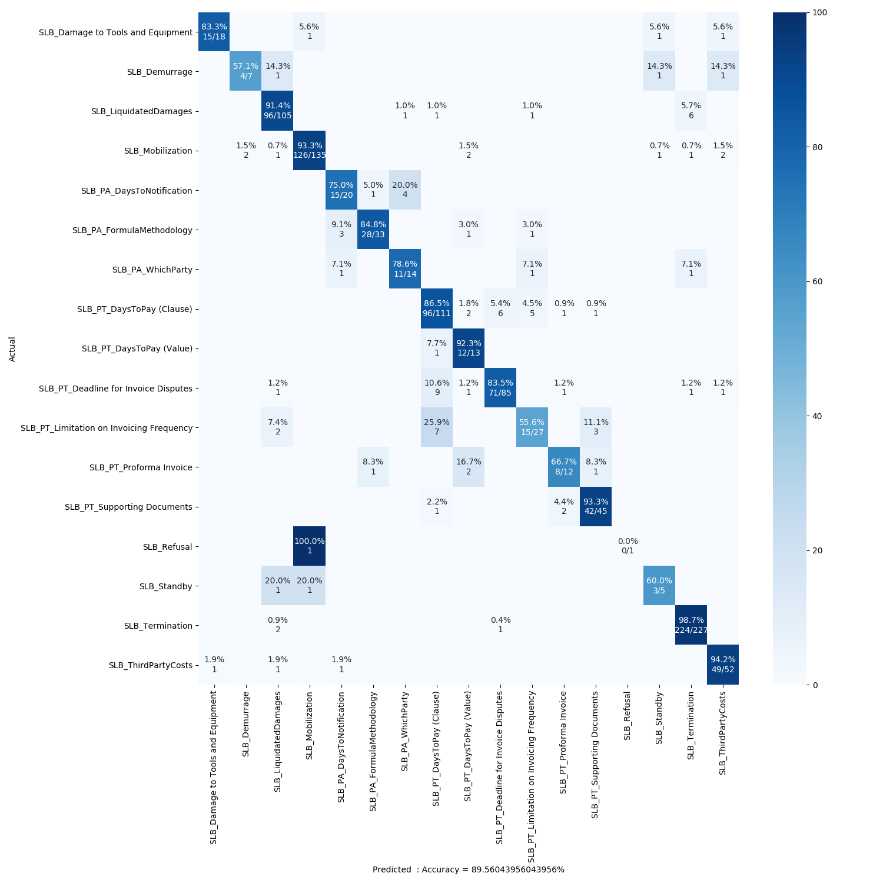
LDA Mallet + SVM Output Results
Predicted Accuracy is :
89.5 %
Confusion matrix of SVM model with LDA features as input

Slide 13
Feature Engineering
For Clustering text data, we need to convert text documents into feature vectors.
Converted each document into a vector of length 156 as shown below.
Text Documents
(n docs)
NLTK Preprocessing
Dictionary Based Preprocessing
Count Vectorizer
Tf-idf
Vectorizer
Linguistic Vectorizer
Custom Vectorizer
Custom Vectorizer
Truncated SVD
Standard Scaler
(n X 3)
Vector Sum, Mean and Length
(n X 3)
Lemmatize
Stopwords Removal
Words Standardization
(n X 120)
(n X 30)
Top 120 features using single value decomposition
Zero Mean Unit Variance
Punctuations Count
Feature words count
Structural features as sentence length, word count, char count, etc.
Final Matrix Shape : n X 156

Slide 14
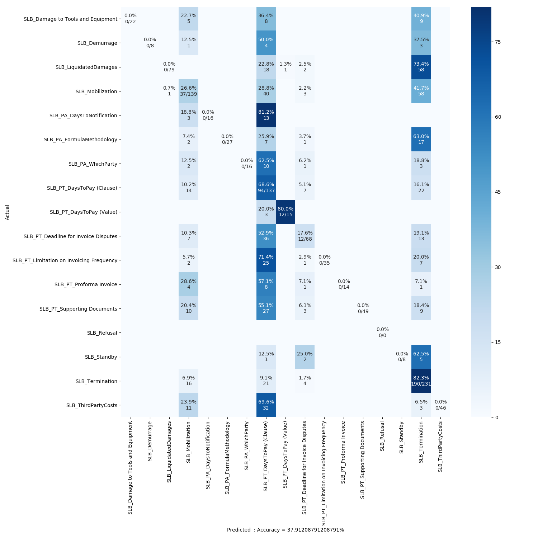
K Means + SVM Output Results
Predicted Accuracy is :
37.9 %
Confusion matrix of SVM model with K Means features as input
Notes:
Inverse of distance to find probability and feature vector

Slide 15
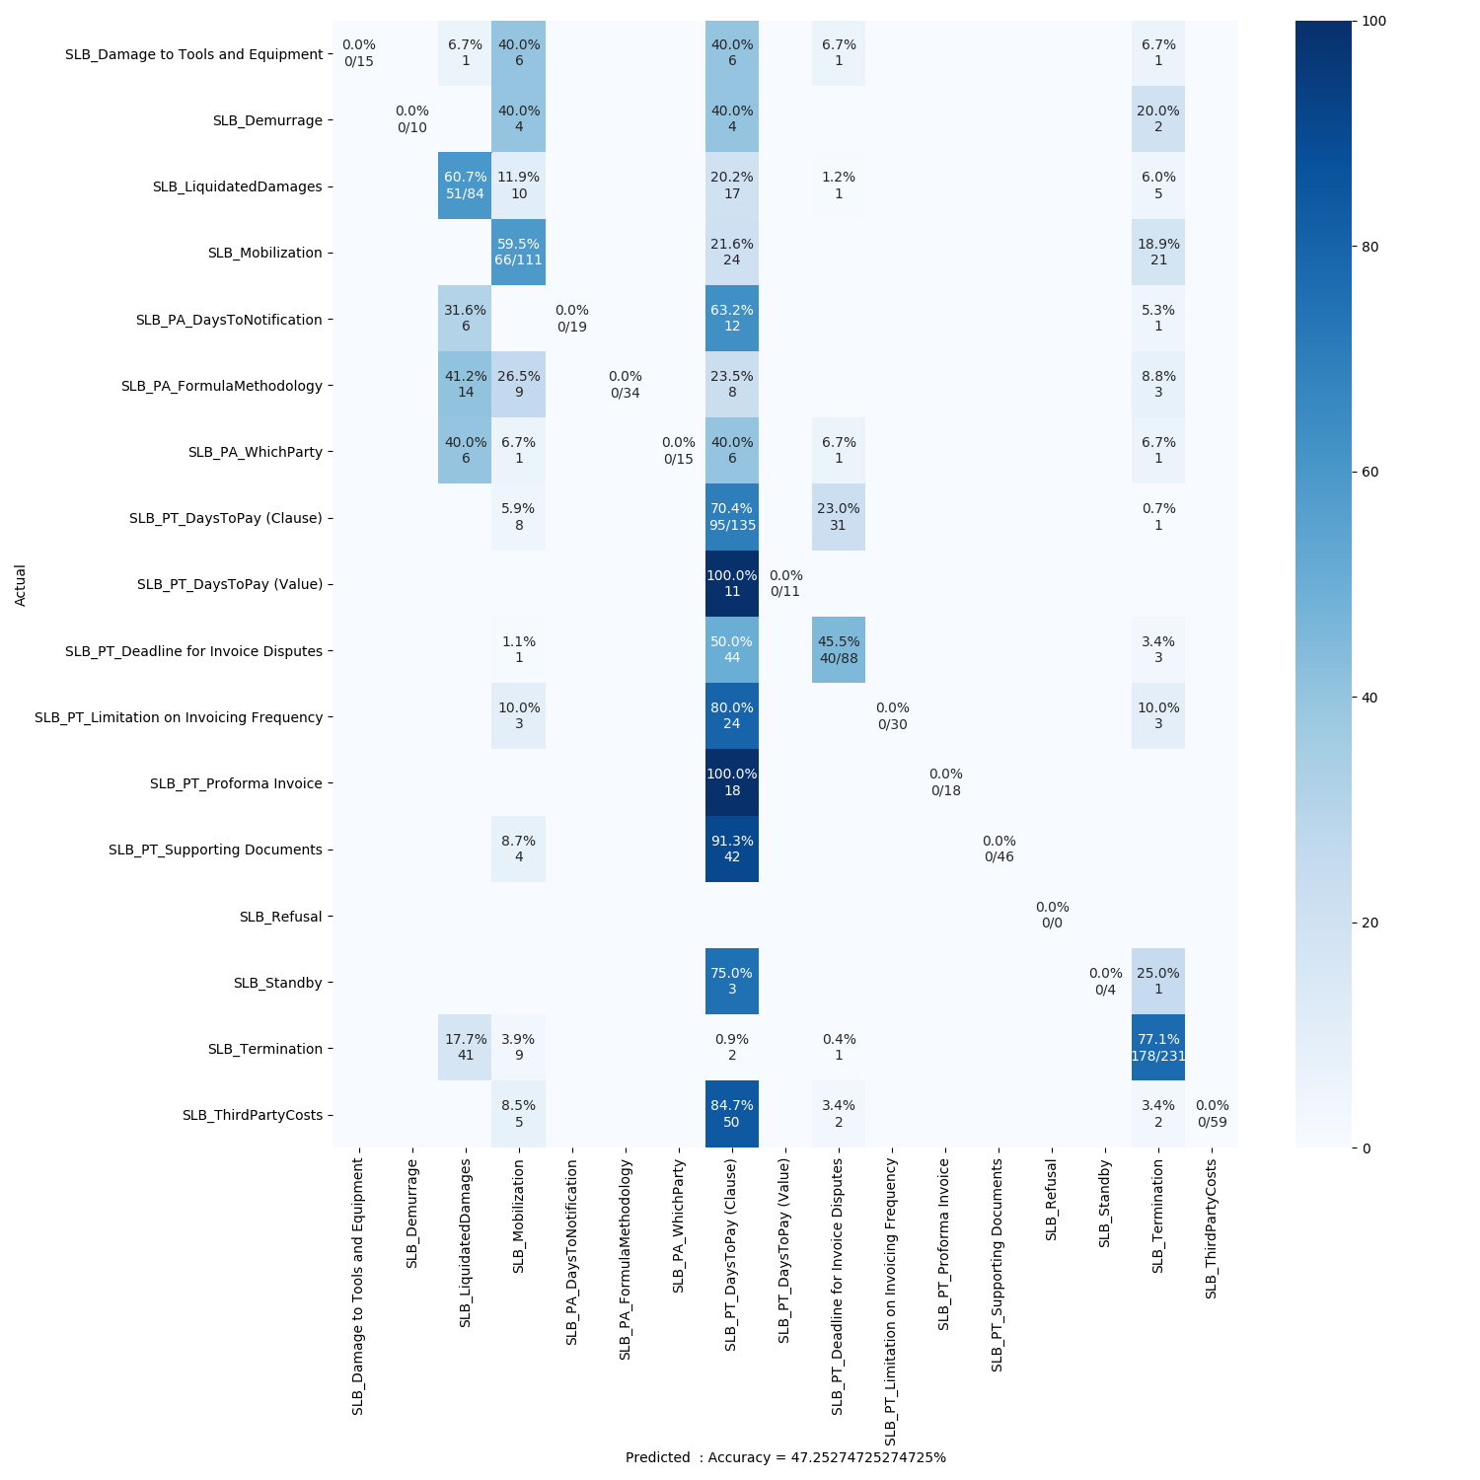
GMM + SVM Output Results
Predicted Accuracy is :
47.25 %
Confusion matrix of SVM model with GMM features as input

Slide 16
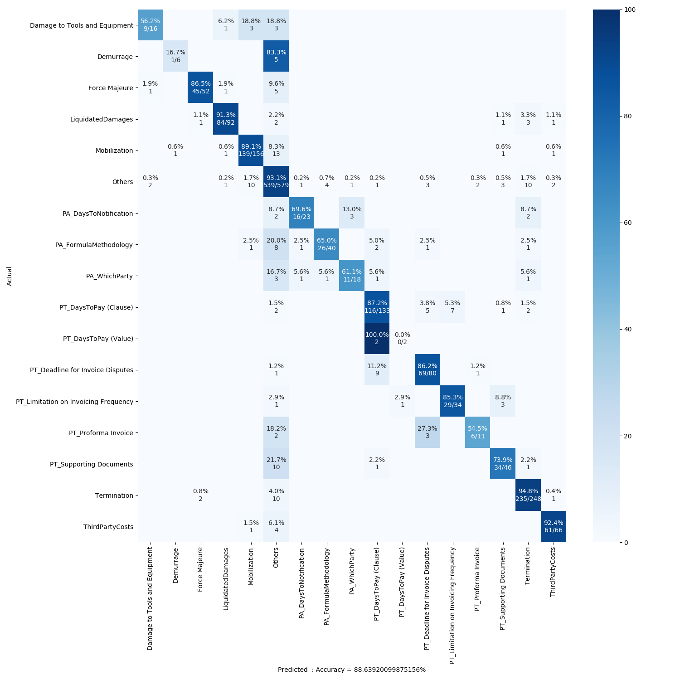
LDA + XGBoost Output Results with 10% others dataset
Predicted Accuracy is :
88.6 %
Confusion matrix of XGBoost model with LDA features as input

Slide 17
Conclusion
Clustering on contracts data does not give useful results.
Topic Modeling has given very good results with accuracy above 90 %.
Future Work
As per the results of LDA and LDA Mallet, we can expect better results with lda2vec which uses word embedding in LDA.
Integration with existing CRT models

Slide 18
Thank You

